Slide 1
MUSIC RECOMMENDATION
TEAM KIT-KAT

Slide 2
MEMBERS
Yash Bhansali 201501028
Hardik Bansal 201501034
Megh Shah 201501081
Parth Doshi 201501229

Slide 3
DATASET
Features:
943 Users
1682 Items
1,00,000 Ratings
Too big Dataset:
Implemented on a small dataset
Content:
Rating (user, item, rating)
Item Genre Info
Format of the Dataset:
Txt Files

Slide 4
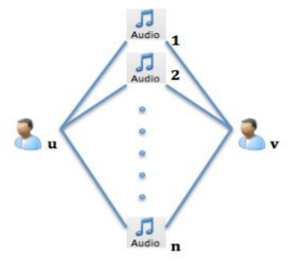
COLLABORATIVE FILTERING ( USER BASED )
Idea: Users who listen to the same songs in the past tend to have similar interests and will probably listen to the same songs in future.
Personalized Recommendation since the prediction is based on the ratings expressed by similar users.

Slide 5
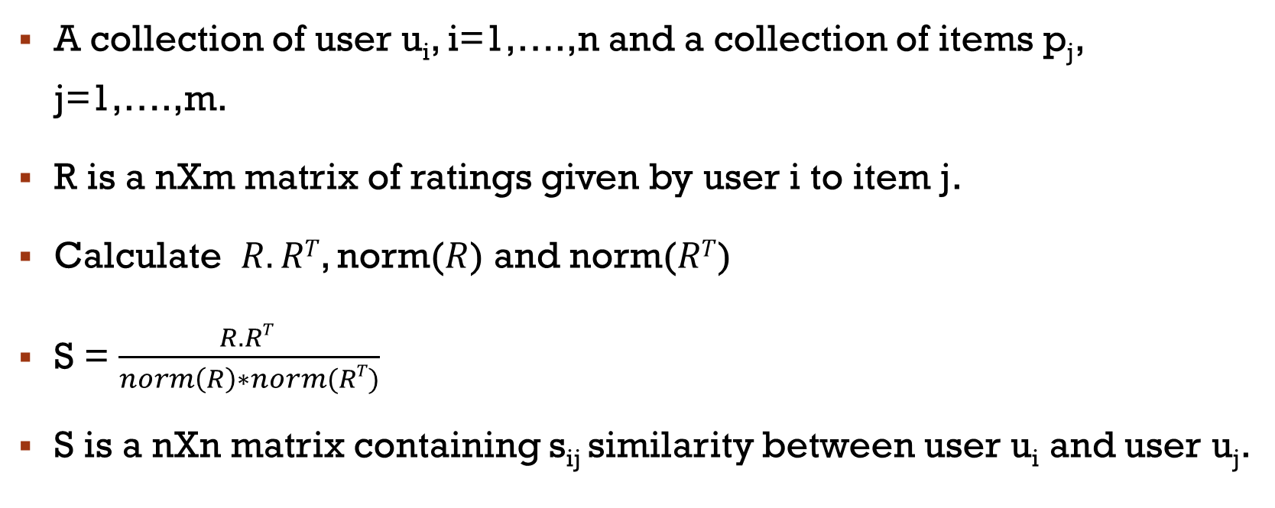
COSINE SIMILARITY

Slide 6
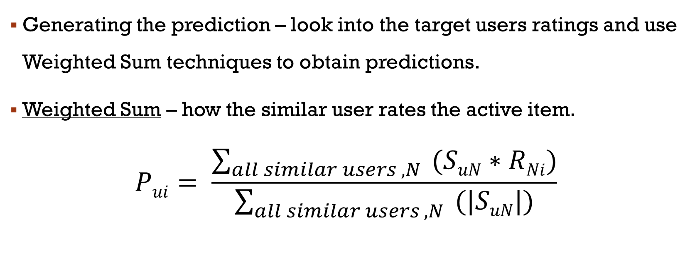
PREDICTION COMPUTATION

Slide 7
RMSE USING COLLABORATIVE FILTERING
The RMSE value computed after using user based collaborative filtering:
RMSE = 0.6028
Training-70%

Slide 8
GENRE – BASED LEARNING
Based on item’s description and user’s preference profile.
Not based on choices of other users with similar interests.
Learn the genre preference of each user on a scale of 1 – 10.
Taken initial genre preference to be 5.
Increase/Decrease the genre preference according to the Reward/Penalty function.

Slide 9
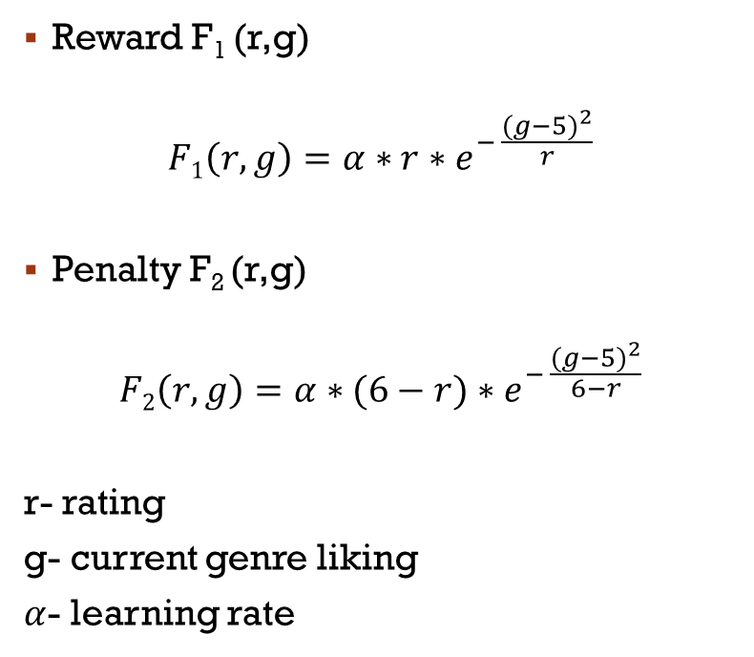
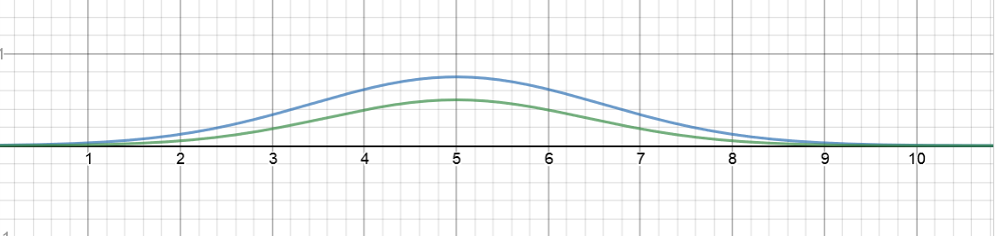
REWARD/PENALTY

Slide 10
HYBRID MODEL
User Based Collaborative Filtering
Genre Based Learning

Slide 11
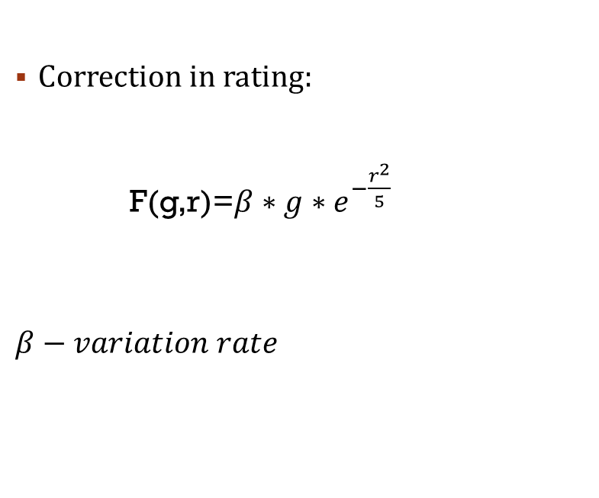
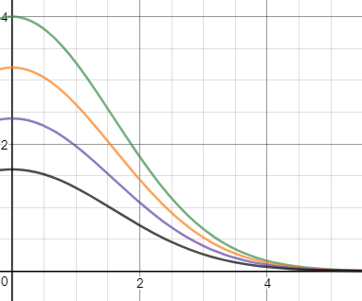
ERROR CORRECTION

Slide 12
RMSE USING HYBRID MODEL
The RMSE value computed after using hybrid model:
RMSE = 0.4956
Training-70%

Slide 13
RECOMMENDATION
Total 10 recommendations:
6 Top Predicted items (User Specific)
2 Top Global (Based on users genre preference)
2 Serendipity

Slide 14
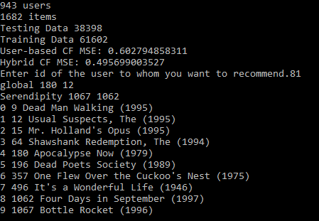
Output

Slide 15
Thank You !

